Slide 1
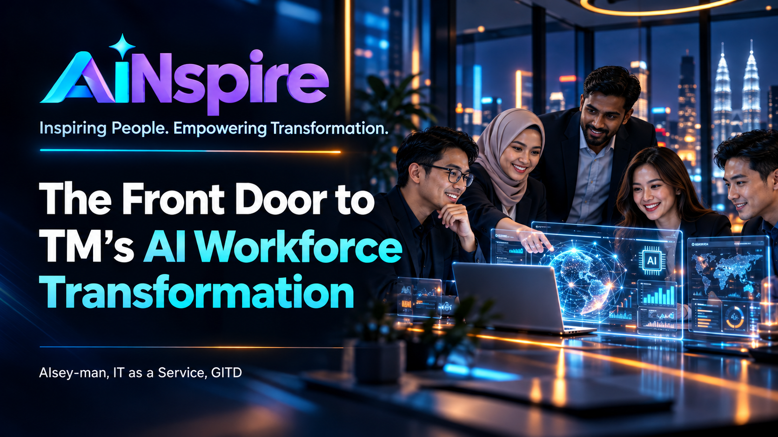
Notes:
What judges look for
Empathy and relevance at Slide 1 — Human-centred problem
Business problem and opportunity at Slide 2 — Why AiNspire
Working prototype and technical innovation at Slide 3 — Live demonstration
Tangible business value and Responsible AI at Slide 4 — Stakeholder outcomes
Scalability and future enhancements at Slide 5 — Vision and roadmap
The opening and closing should form one continuous story.
Opening: Two employees. Different AI readiness. The same training.
Closing: Two employees. Different AI readiness. Personalised opportunities to grow.
That symmetry gives the judges a human story to remember, rather than just another technology demonstration.

Slide 2
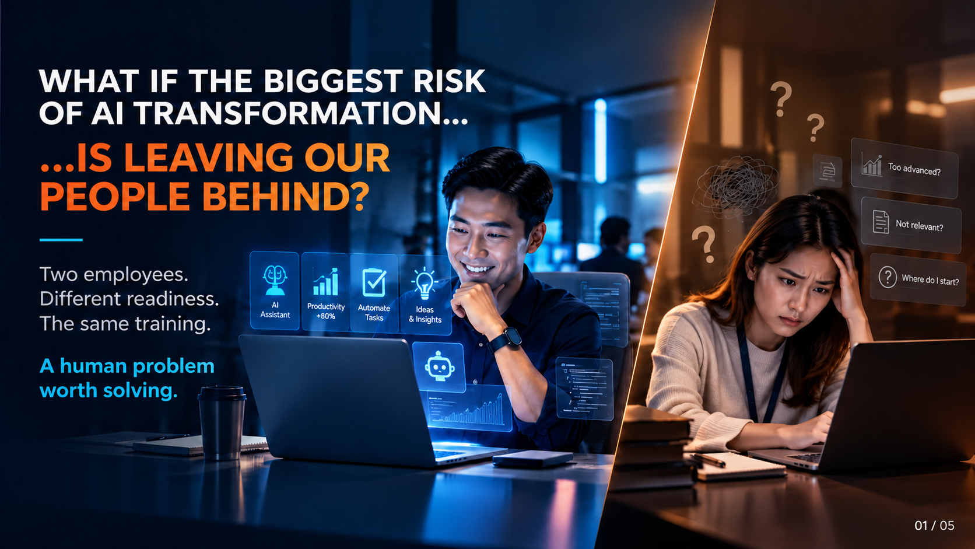
Notes:
Good morning, judges. Before I introduce AiNspire, let me ask you one question. What if the biggest risk of AI transformation isn't technology… but leaving our people behind?
Imagine two employees. One is already confident using AI. The other is still figuring out where to begin. Yet both attend the same AI training. For one, it's too basic. For the other, it's overwhelming. Same training. Different readiness. Different outcomes.
Now imagine this challenge across thousands of employees. That's the human problem we want to solve with AiNspire.
Transition → Slide 2
And it leads us to a fundamental question: How can we develop our people if we don't first understand their readiness?

Slide 3
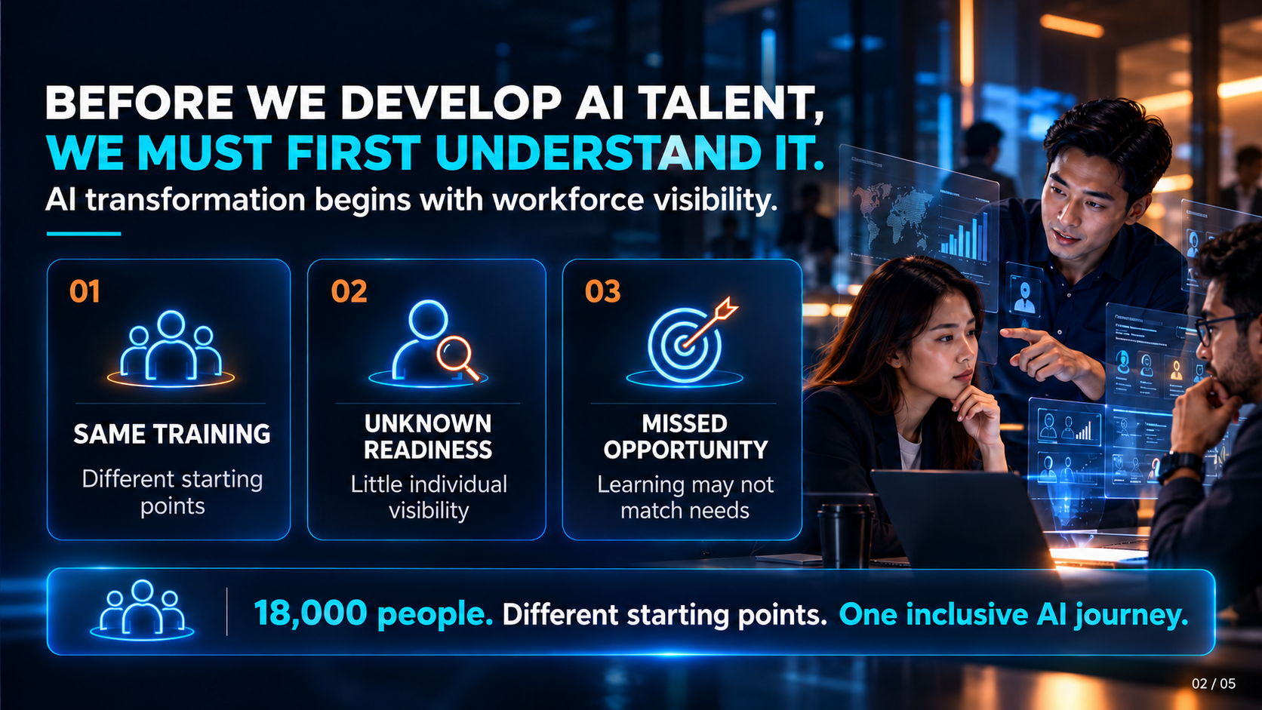
Notes:
TM aspires to become an AI-driven organisation. But our employees are not starting from the same point.
Today, we face three challenges.
First, one-size-fits-all training.
Second, limited visibility into individual AI readiness.
Third, missed opportunities when learning doesn't match actual needs.
Across 18,000 employees, these gaps matter. We don't just need more AI training. We need to know who needs what, and why.
Transition → Slide 3
So, instead of asking everyone to follow the same learning journey, what if AI could help us personalise it?

Slide 4
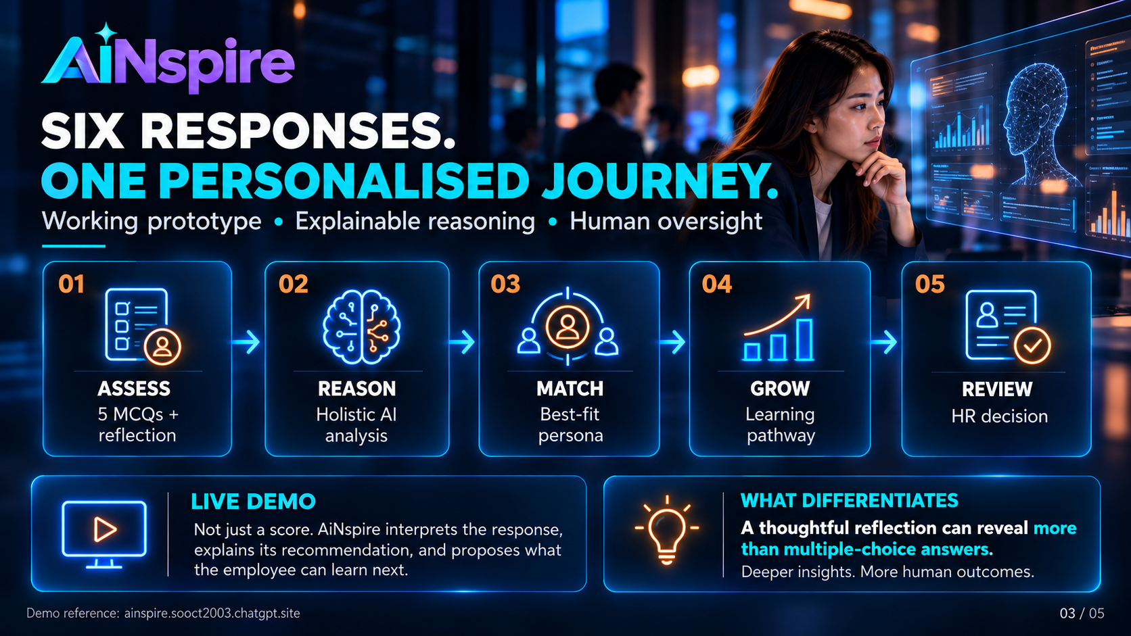
Notes:
That's why we built AiNspire. Let me show you how it works.
An employee answers just five questions and one reflection. AiNspire then analyses their responses holistically, identifies a best-fit AI persona, explains its reasoning and recommends a personalised learning pathway. But here's what makes AiNspire different. It doesn't simply count answers. It considers what employees actually express about their experience.
Let me demonstrate. [LIVE DEMO — approximately 50 seconds]
Show the completed employee assessment.
Reveal the AI-recommended persona.
Highlight the reasoning and confidence indicator.
Show the personalised learning pathway and employee report.
And importantly, HR retains the final decision.
AI reasons. Humans decide.
Transition → Slide 4
Now imagine what this means, not just for one employee, but across the organisation.
Delivery Guide:
Recommended demo scenario: Use an employee whose reflection demonstrates meaningful practical AI experience, even though some multiple-choice responses suggest lower readiness. This is a stronger demonstration of holistic reasoning than showing only an obvious high-scoring candidate.
Keep the completed assessment ready before the pitch. You should not spend time typing all six responses live.
Do not explain the entire interface. Show the transformation from employee responses into an explainable, actionable learning recommendation. The confidence indicator reflects the prototype's internal assessment and should not be described as a calibrated probability of accuracy.

Slide 5
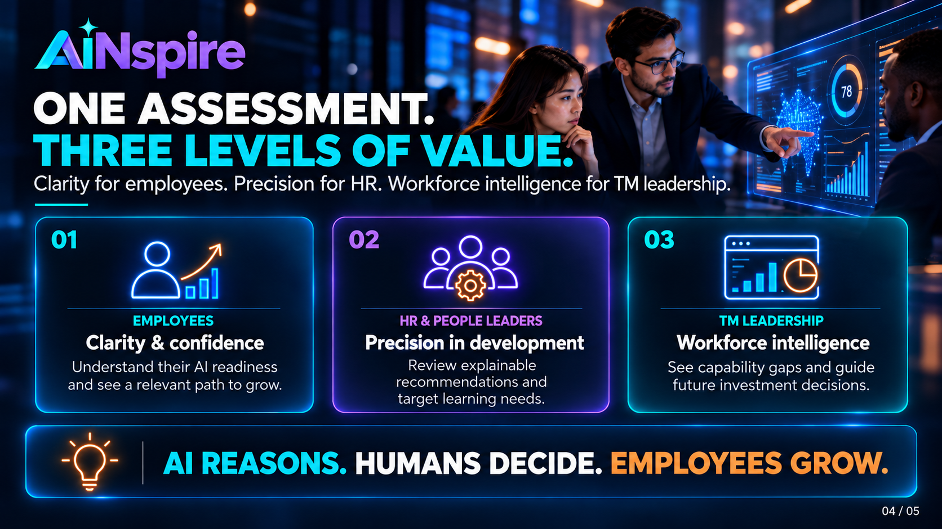
Notes:
What you've just seen is more than an assessment. It creates three levels of value.
For employees, clarity and confidence. They understand where they stand and how to grow.
For HR, precision in development. Learning can be better aligned to actual capability needs.
For TM leadership, workforce intelligence. We can begin identifying capability gaps and making more informed development investments.
And here's something equally important. AiNspire is designed around explainability, transparency and human oversight. Because AI should support people, not make decisions about their future without them.
Transition → Slide 5
So, where do we go from here? From one assessment to an organisation-wide opportunity.
Delivery guidance:
Build the narrative from the individual employee to HR and finally to TM leadership. This progression demonstrates that AiNspire has both human value and enterprise potential.

Slide 6
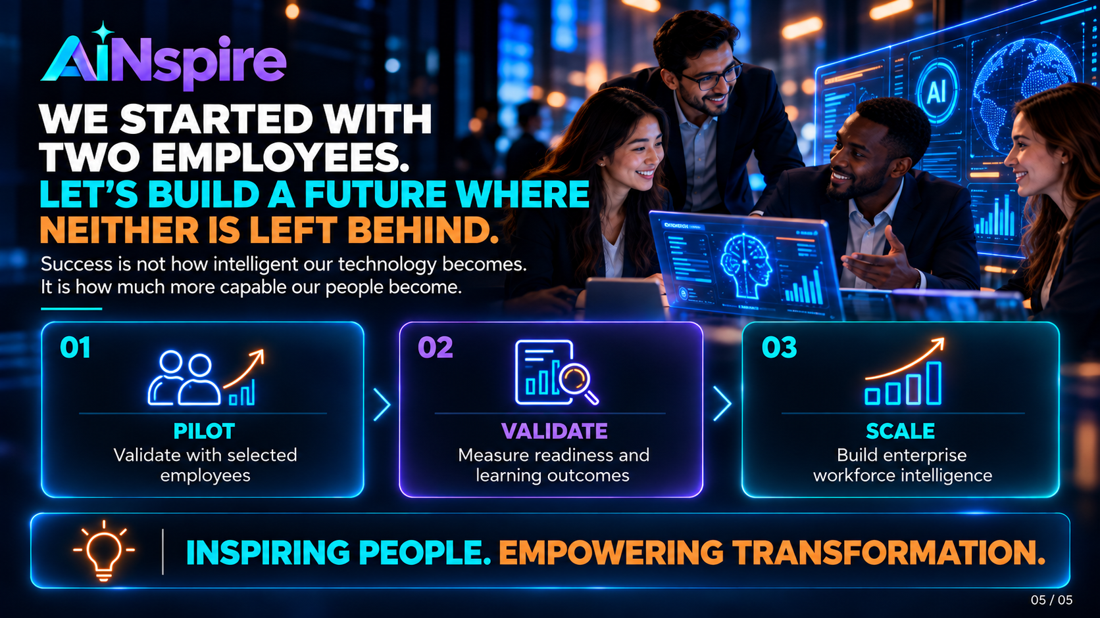
Notes:
Remember the two employees we started with? One confident with AI. The other uncertain where to begin.
Our ambition is simple: neither should be left behind. We are not building an AI assessment tool. We are building a future where every employee has the opportunity to grow with AI. [Brief pause]
Because ultimately…The success of AI transformation is not measured by how intelligent our technology becomes. [Pause] It is measured by how much more capable our PEOPLE become. [Pause] That is AiNspire.
Inspiring People. Empowering Transformation. Thank you.
Delivery guidance:
Return your attention to the judges when saying "Remember the two employees we started with?" Slow down for the final three statements. Avoid rushing the closing; the emotional connection between Slide 1 and Slide 5 is what makes the story memorable.

Slide 7
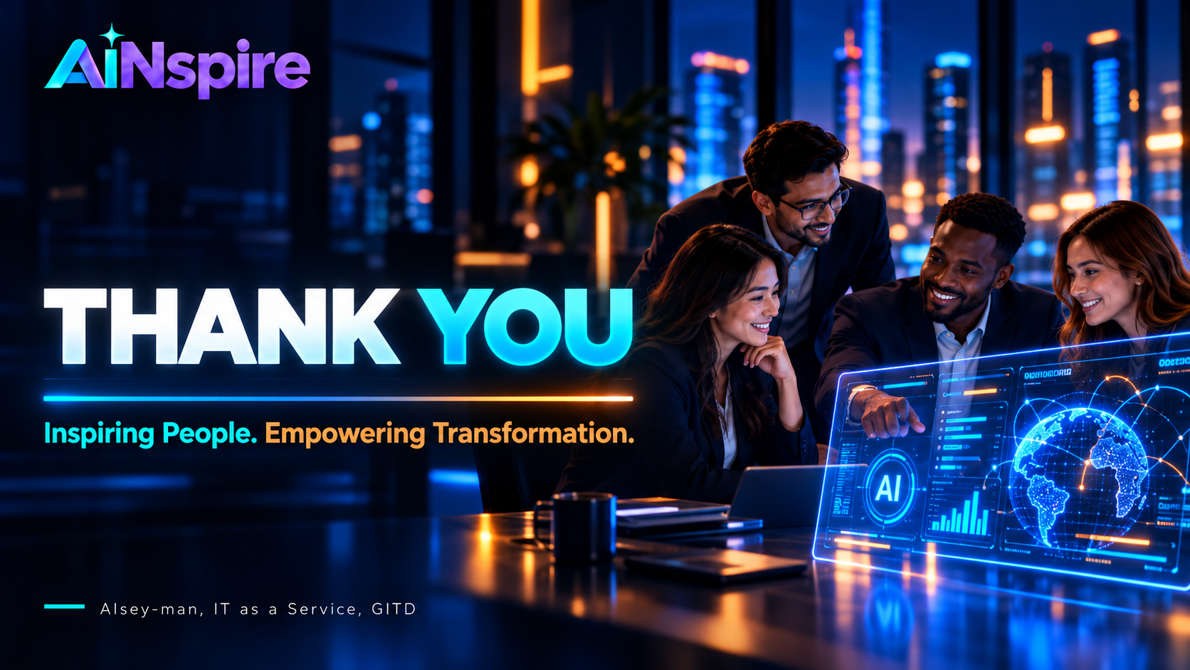
Notes:
The most compelling overall storyline is therefore:
Slide 1: No employee should be left behind.
Slide 2: We cannot develop what we do not understand.
Slide 3: AiNspire demonstrates how individual readiness can be understood.
Slide 4: Personalised development creates value for employees, HR and leadership.
Slide 5: The true measure of AI transformation is how much more capable our people become.
That creates a consistent narrative from empathy → evidence → impact → inspiration.
And if the judges remember only one sentence after hearing several hackathon pitches, I would want it to be:
"The true measure of AI transformation isn't how intelligent our technology becomes. It's how much more capable our people become."

